Slide 1
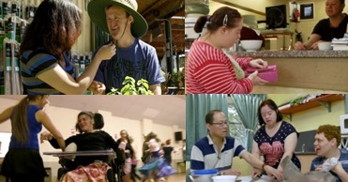
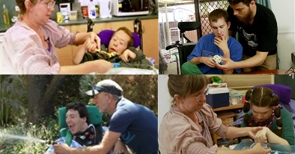
Day 2 Active Support: what it is and how to do it
Training developed by the Living with Disability Research Centre

Slide 2
Plan for Today
You will learn more about
  Applying the 4 Essentials of Active Support
  The importance of supportive relationships to good Active Support
  Supporting social interactions
  Communication
  Supporting a group of people
  You will also learn about
  How Active Support fits with other person centred practices
  Staff experiences of putting Active Support into practice and continuous improvement

Slide 3
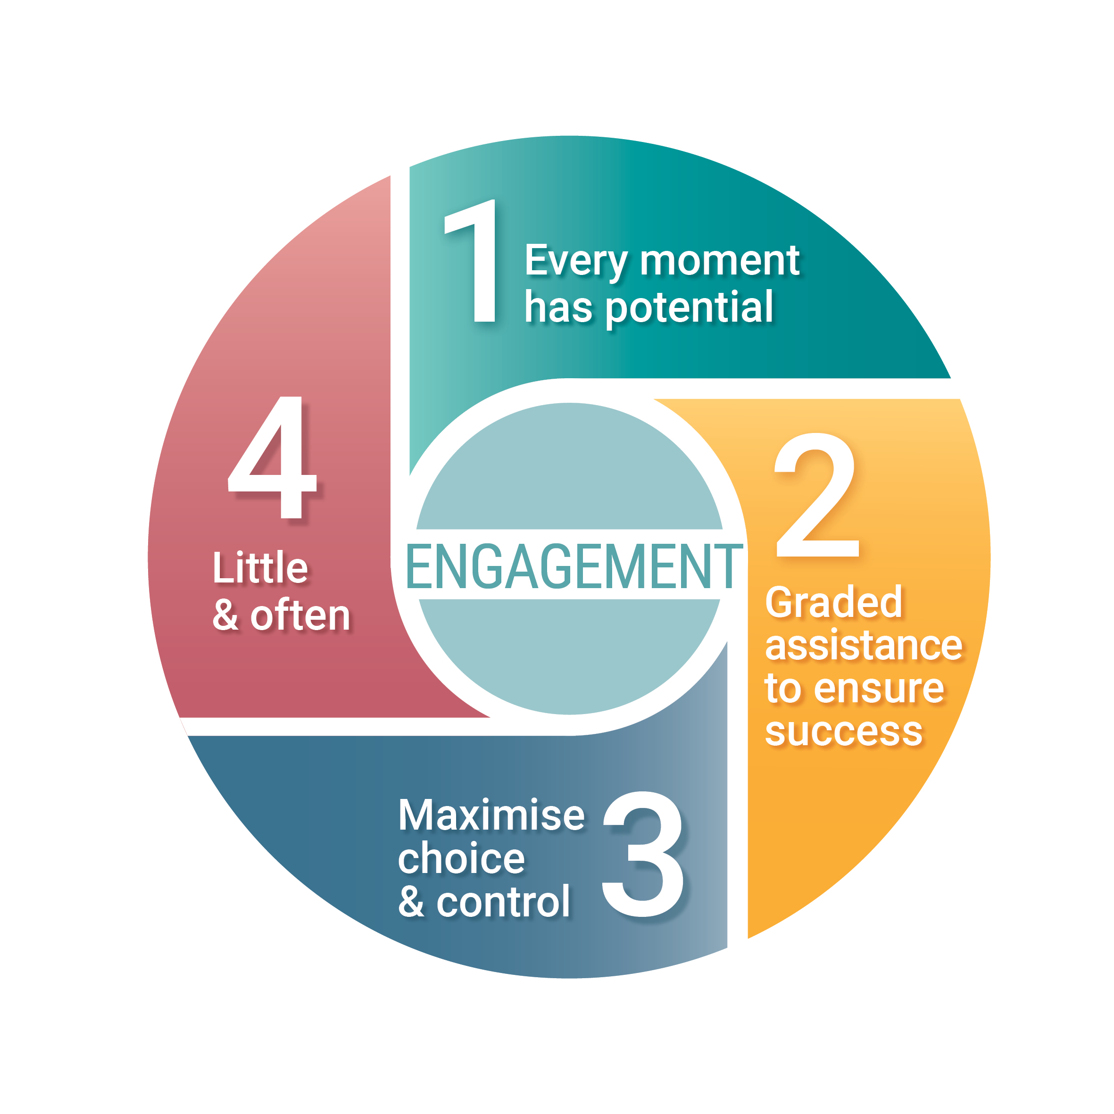
Recapping the 4 Essentials of Active Support
Can you summarise what each of the 4 Essentials are about and what they look like in practice?
Notes:
Ask people to write down two sentences about what they understand each essential to be.
Every moment has potential – every task, activity or interaction has opportunities to involve a person
Graded assistance to ensure success – provide the right type of support to assist a person to succeed in an activity or social interaction
​​
Maximising choice and control – offer choices to increase a person’s control over their life
​​
Little and often – support a person to try new things or participate for a short time to increase their experience

Slide 4
Good Relationships Characterise Active Support
The 4 Essentials guide the type of support you provide
How you provide support and interact with a person are also important
This means:
    Being respectful at all times
    Creating a friendly atmosphere
    Having warm relationships with the people you support
Notes:
Key message
The 4 essentials guide the type of support you provide but How you deliver it is also part of Active Support
It is not a mechanical process, impersonal and overly task focussed.
Your interactions need to be respectful – warm and respectful

Slide 5
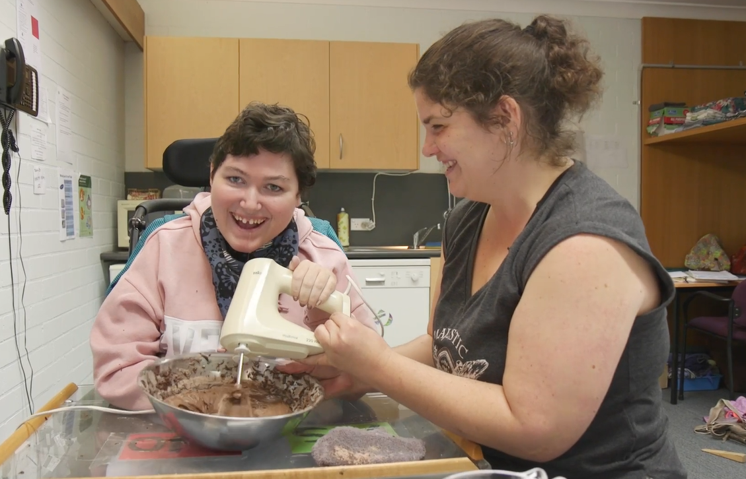
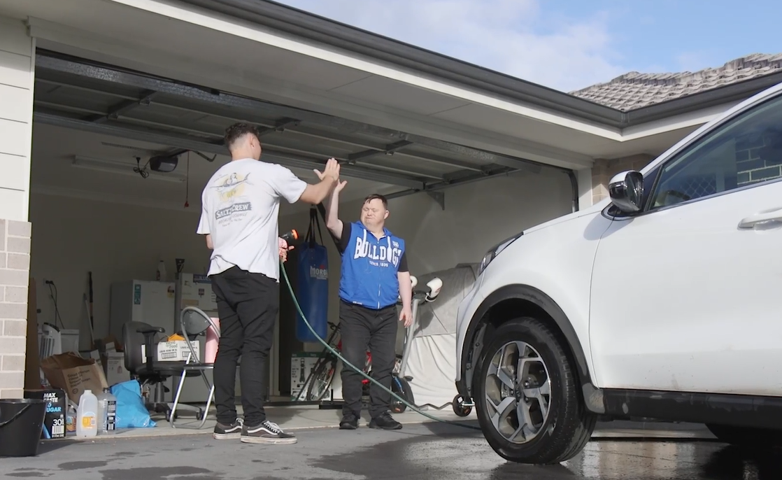
Creating a Friendly Atmosphere
How you create a friendly atmosphere depends on the person and the situation
You can:
  Smile
  Praise or encourage the person
  Have moments of fun
  Share a joke or laugh together
  Make small talk
Take care:
  Not to overwhelm the person by talking too much
  Not to distract a person when they are concentrating
  To recognise and respect when a person wants to be alone or quiet
Notes:
Key message – the actions of staff can create a friendly atmosphere there are various was to do this. Creating a friendly atmosphere may not always be appropriate for a particular person at a particular time.
Some people can get overwhelmed by noise or talking, some need quiet to concentrate, or have times when they want to be left alone
Introduce the video which shows how staff can create a friendly atmosphere

Slide 6


Slide 7
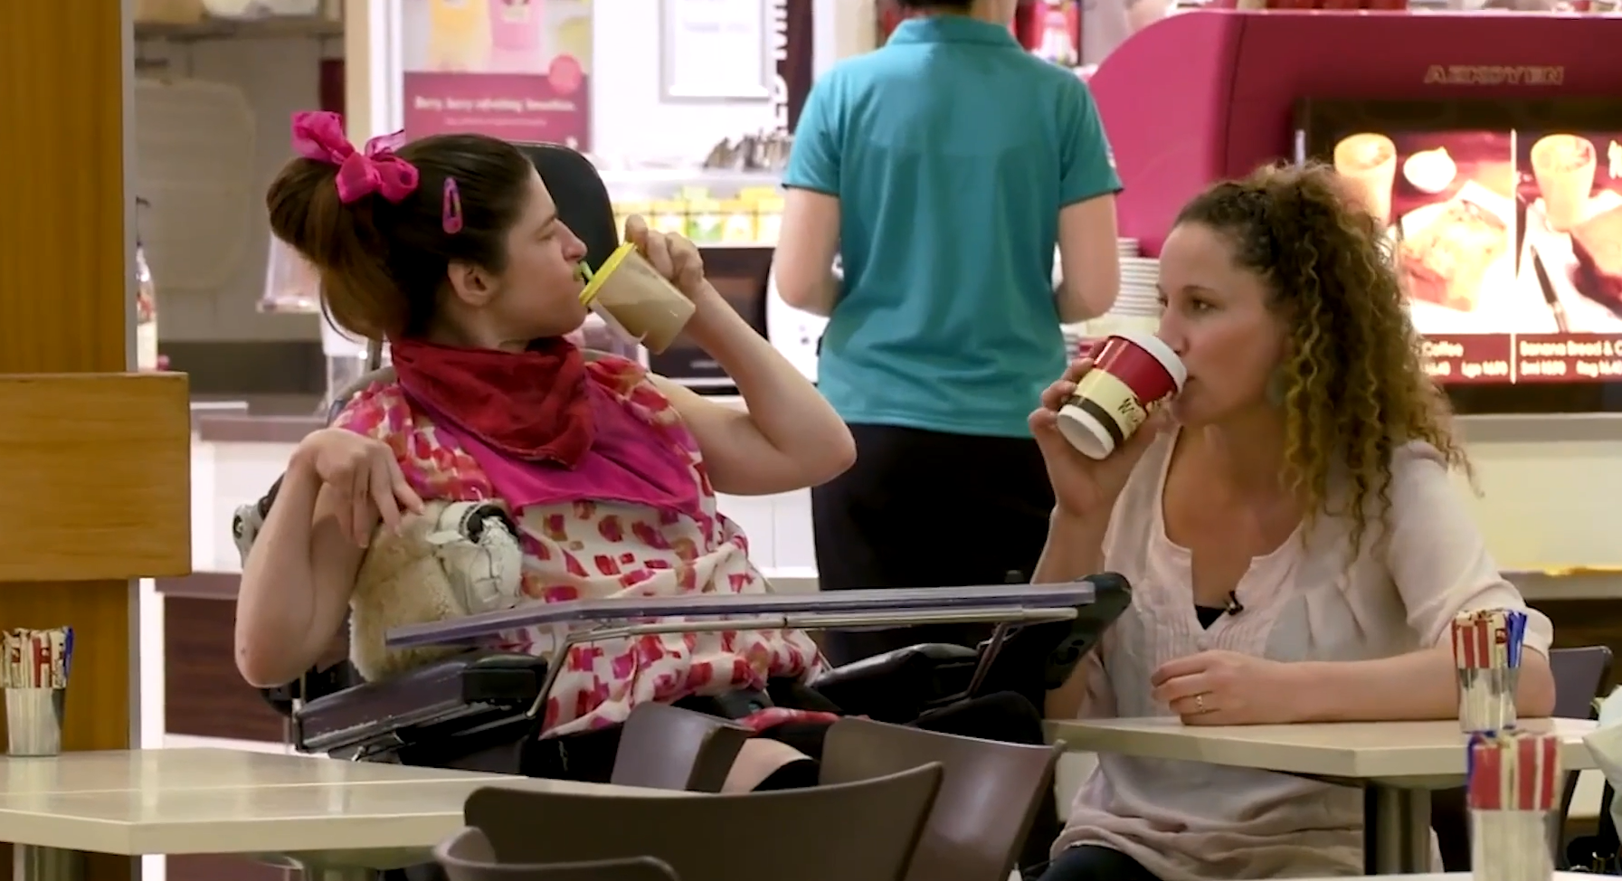
Warm Relationships
Warm relationships with the people you support contribute to good Active Support
When you are building relationships it helps if you:
    Know a person - their likes and interests - their sense of humour – their style
  Spend time with the person
  Have shared experiences
  Can identify shared interests
Does the service where you work value good relationships and social interactions between staff and the people you support?
Notes:
Shared interests may be following a sport or certain team, TV shows, music, animals or pets, a hobby or knowledge of the local area.
There is a fine line here which may be raised – so the message is You need to be careful that the relationship does not become so close that you are a “paid friend”, or dependency is created.
At the same time as staff having good relationships with the people they support, they should also support people to have relationships with people outside the service – family, friends, peers, - dealt with next

Slide 8
Supporting Social Interactions
For most people, relationships are important to their quality of life.
People can have different types of relationships – each is important for different reasons
For example,
  Close and long term relationships provide warmth and love
  Casual acquaintances provide companionship and personal affirmation
  Short term or fleeting relationships give moments of recognition
New relationships are made through social interaction
Existing relationships are maintained through regular contact
You can use the 4 Essentials of Active Support to support a person to engage in social interactions and form relationships
Notes:
Key message. - people have different types of relationships, they are all important but look different – and give different things to the person
They may feel warmth and love from a close family member
Have fun with friends
Get a sense of acknowledgement from strangers who say hello or know their name for example people in shops they go to regularly
Staff can support people to develop and maintain relationships

Slide 9
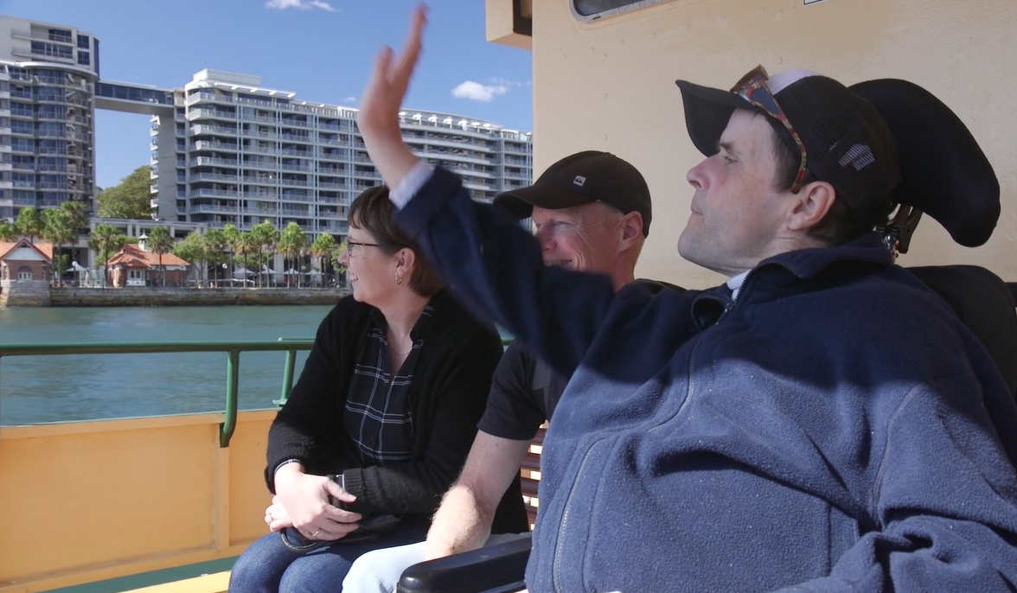
Looking for Opportunities for Engagement in Social Interactions
Remember Every Moment Has Potential
You need to recognise and/or create opportunities to support social interactions
  at home:
    conversations with housemates or visitors
    using technology to contact friends or family
  in the community:
      participating in activities where there are other people – classes or volunteering
      commercial exchanges – with shop assistants, baristas, receptionists
      planning meetings with friends or family
      incidental encounters with neighbours or people you recognise
Notes:
Key message. Lots of opportunities to support social interactions these occur in different places and look different, give examples
at home (e.g., among co-residents, with visitors),
in the community (e.g., shop assistant, doctor) or using technology (e.g., texting a friend).
Introduce the video that shows ways of supporting social interactions

Slide 10
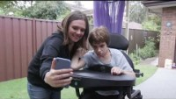

Slide 11
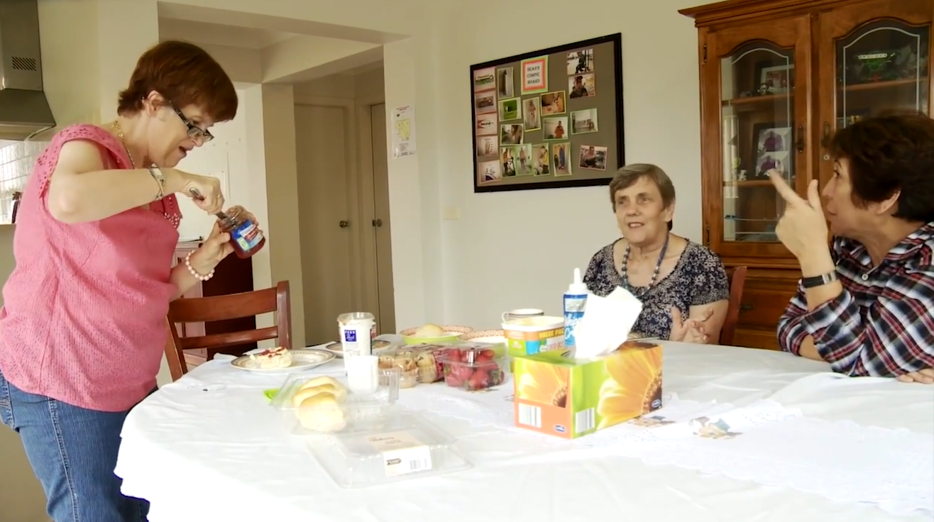
Assisting Social Interactions
Use Graded Assistance to ensure success
The type and amount of assistance you provide depends on the person and the situation
You need to interpret the situation to provide the right type and amount of assistance
Think about
  How familiar is the person with other people
  How do they understand the social situation
  How do they communicate
  How are they seen by others - will they be understood
The next video shows examples of providing graded assistance to support social interactions
Watch for the different types of assistance that is provided
Notes:
Message: supporting social interactions like other support depends on judgement about the right amount and type of assistance necessary
Staff need to take into account, the situation, the person and the others involved.
Introduce the Video

Slide 12


Slide 13
Activity: Assistance in Social Interactions
What assistance was provided in the interactions?
What do you think the interactions were like for the people involved?
Was the right type and amount of assistance provided?
Notes:
Use discussion to reflect on types of assistance in the video - what might have been done differently ?

Slide 14
Using Graded Assistance in Social Interactions
Examples of graded assistance are:
  Prompting a person to say hello when they see someone they know
  Introducing a person when they meet someone new
  Interpreting or repeating what a person has said if others find it hard to understand
  Helping a person to understand and respond if they are not sure what is being asked of them
  Helping to start a conversation – using your knowledge of the person and their activities
  Filling in gaps in conversation
Too much assistance can mean you do too much talking, which excludes the person.
But too little assistance can mean the people interacting don’t understand each other and the interaction breaks down.
Notes:
Concrete examples of different types of assistance with social interactions.
Assistance requires judgement about how and when to provide support –
If the person can interact independently in a conversation, then as with other types of support you will need to decide whether to just stand back or join in the conversation and participate naturally
You can use the previous video to identify examples of when these were used

Slide 15
Communication and Active Support
Good communication is key to all 4 Essentials of Active Support
It helps a person understand:
      activities they might do
      the options offered to them
      how to participate
      what to expect
    Good communication also helps a person to feel included and enjoy interacting
Communication is a two way process – giving and receiving messages
So listening carefully to the other person is also part of good communication
Look for examples of good communication in the video and notice how staff adjust their communication to each person they support
Notes:
Key message – communication runs all through all the 4 essentials – and is essential to good Active Support
Highlight reasons why communication is important to good support
Communication goes two ways, listening and responding
Prompt for what to look for in the video

Slide 16
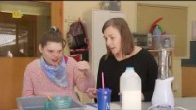

Slide 17
Adjusting Your Communication
Everyone communicates in different ways
You must adjust your communication to each person you support
You may need to give the person time to understand and respond
You may need to check if the person understands your message and that you have understood theirs
Notes:
Key message – need to adjust communication to each individual

Slide 18
Verbal Communication
If a person understands words it helps to:
    Speak clearly and not too fast
    Use short sentences and words familiar to the person
    Give one message at a time
    If the person hasn’t understood, restate the message using shorter sentences and focusing on key words
    Use objects, gestures, facial expression or pictures as well as words to make the message clearer
Notes:
If you use words – slow down, one message at a time, check the person understands if not restate
Use other ways of communicating to go with words. Objects pictures etc

Slide 19
Using Other Forms of Communication
Use other forms of communication with people who have difficulty understanding words
This might include
  Objects
  Gestures
  Facial expressions or body movements
  Pictures or photos
Some people use key word sign – you will need to learn the signs they use
Some people use communication aids – such as chat books, yes/no buttons, picture board, programs such as Pro lo quo on an iPad
You will need to learn how a person uses their communication aid and you may need to support them to use it
Notes:
Some people do not use words to communication- they may respond to your tone but not understand the words or the message
There are ways of communicating without words
If people have communication aids make sure you use them and the person has access to them – don’t leave them at home

Slide 20
Supporting a Group of People to be Engaged
So far we have been learning how to support one person, but at times you will be supporting a group
You may be supporting a group of people to do same activity, such as playing a game or cooking, or several people each engaged in different activities
You use the same 4 Essentials of Active Support if you are supporting more than one person
But there are some additional strategies to use:
  First set up each person to be engaged with an activity
  Then rotate your attention around each person
  Think about the steps for each person’s activity
  Adjust your support as the activity progresses
  Position yourself in the right place
The next video explains more about these strategies and shows you some examples of supporting a group
Notes:
Key Message
You need to learn the skills in Active Support to support one person first and then learn how to support a group as there is more you need to pay attention to
There are strategies you can use if you are supporting a group –overarching things to remember are listed in the slide assisting each person individually to engage by starting with one person and moving around the group.
Its better to rotate than spend too much time with one person- where you position your self is important
Introduce the video

Slide 21
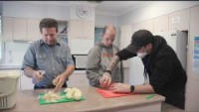

Slide 22
Different Support Needs within the Group
The support needs of each person in the group will vary.
Some may require the activity to be set up, then they can remain engaged doing each step independently with prompts and encouragement.
Others may require more support, such as hand-over-hand assistance to remain engaged
Where you position yourself is important and will depend on the situation.
For example, you might position yourself between the people you are supporting, opposite them, or closest to the person who requires the most support.
When supporting a group, small talk and friendly interactions can create a friendly atmosphere.
As you watch the video think about
  What were the people doing and how much were they engaged?
  What strategies did the staff use to assist them to be engaged?
  How effective were the strategies?
Notes:
Message reinforcing need to pay attention to each person – and the support they need which will be different
Where you position yourself is important
Intro to the video and orientation questions

Slide 23
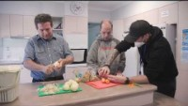

Slide 24
Activity: Supporting a Group
How did the staff provide assistance to the groups of people?
What were the people doing and how much were they engaged?
What strategies did the staff use to assist them to be engaged?
How effective were the strategies?
Notes:
Discuss the questions for the video
Restate key strategies for working with groups
Setting up the activity for each person to participate
Rotating around each person
Thinking in steps
Adjusting your support
Positioning yourself in the right place

Slide 25
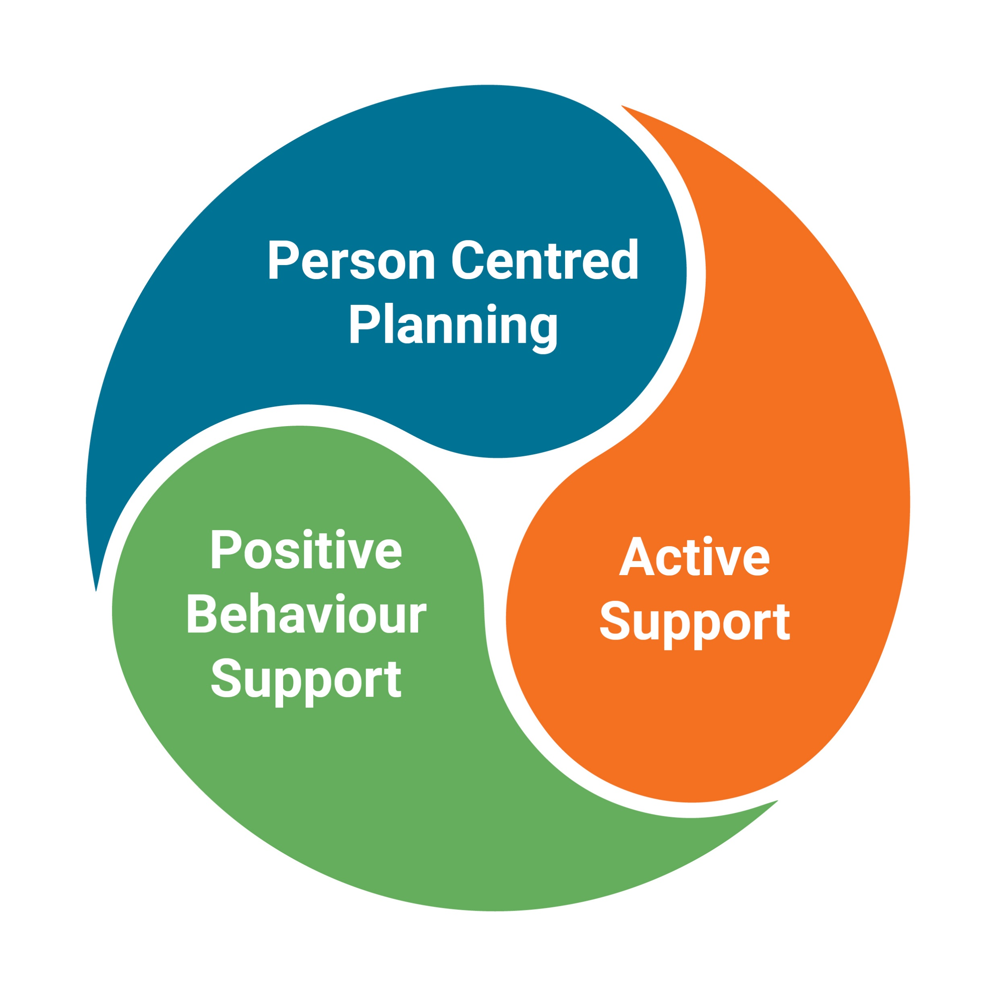
Connecting Active Support with Other Person Centred Practices
Being person centred means putting the individual at the centre of everything you do
Active Support, Person Centred Planning and Positive Behaviour Support are all person centred practices
These practices are connected, and you can use them together to improve a person’s quality of life
Notes:
Key message
Define person centred - connect AS, PBS and PCP together as person centred practices that can be used together
Many people will have a person centred plan and will receive Active Support.
Some people will also have a behaviour support plan.
Emphasise that all three of these practices aim to improve people’s qualty of life

Slide 26


Slide 27
Active Support and Person Centred Planning
Active Support is a way of working all the time to support a person to engage in activities and social interactions
When you do Active Support, you learn a lot about a person by spending time with them and trying things
Your knowledge about a person’s interests, wants and needs can help inform their Person Centred Plan which sets out their goals
Using Active Support helps to implement person centred plans by turning goals into activities.
Notes:
Key message – your knowledge from Active Support can help to inform a person’s plan. And you can use Active Support to turn big picture goals into activities.
Goals are important But there is more to support than reaching specific goals - how the person is engaged and supported all through their day is as important to quality of life as reaching specific goals
PCP and the NDIS focus on goals can distract attention from every day support

Slide 28
Active Support and Positive Behaviour Support
Positive Behaviour Support is used to understand behaviours of concern and plan support for a person
Good communication and being engaged are part of many behaviour support plans
Active Support is often part of behaviour support plans
Staff following the plan and using Active Support can reduce behaviours of concern
Notes:
Key message Active Support is not separate from PBS – they often focus on the importance of supporting a person to be engaged in activities that are meaningful to them, and on good communication. This is what Active Support aims to do.
Also if staff use Active Support well evidence shows behaviours of concern reduce. – following a plan and using Active Support are even more effective

Slide 29
Improving Active Support Over Time
Developing skills in Active Support takes time
Your skills will improve as you build up your experience and reflect on your practice
Being supported to be engaged may be a new experience for some of the people you support
You may need to build up a person’s experience and success of being supported rather than attempting too much too soon
You will see changes in the people you support as their experience grows and your skills get better
When trying and learning to use Active Support, it may be best to start small:
  Identify activities and interactions that are more likely to succeed
  Support a person in an activity that they already participate, or have an interest
  Learn from the experience and identify how to do it better next time
  Then have another try and gradually incorporate more techniques
In this video Anita talks about her experience of supporting Laura
Notes:
Key message Building skills takes time – Being supported to be engaged may be new to some people – it my take time for someone to accept being supported –

Slide 30
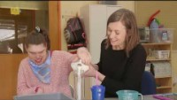

Slide 31
Reflecting on Practice to Develop Active Support
Reflecting on your practice will help improve your skills
This means thinking about the support you have provided and ways of improving it
Ask yourself the following questions:
What happened during the activity or interaction?
What support did I provide?
What was it like for the person I supported?
What was it like for me?
What worked well?
What could I improve?
What could I do differently next time?
You can reflect by yourself, with another team member, in staff meetings or in supervision
In the next video staff talk about how what helped to improve their Active Support skills
Notes:
Key message. Reflection is really important to building up skills – Questions you might ask yourself

Slide 32


Slide 33
Activity: Improving practice
What did the staff identify that helped them improve?
What aspects of Active Support will you work on?
What will you do to improve your skills in Active Support?

Slide 34
Implementing and Maintaining Active Support
Many years of research show that when staff use Active Support people with intellectual disabilities experience significant increases in levels of engagement and quality of life
Maintaining Active Support over time requires commitment from every staff member and support from their organisation
For example,
  All new staff should be introduced to Active Support as part of their induction
  New staff have ways of getting to know the people they support - doing shadow shifts with experienced staff, sharing information in staff meetings, reading one page profiles
  Priorities and expectations of staff are clear – Active Support and not the Hotel Model
  Direct support workers are trained in Active Support and receive good Practice Leadership - including feedback, coaching, supervision, team meetings, shift planning that focus on quality of life and Active Support
  Frontline supervisors are skilled in Active Support and Practice Leadership
  Senior managers understand the language and significance of Active Support
Notes:
This slide may need to be adapted depending on the audience. Main message staff need to be committed and should expect to supported by their organisation to do Active Support

Slide 35
Activity: Resistance to Active Support
Some staff may believe that Active Support is not practical. They may say:
  We don’t have the time. It’s quicker for staff do it.
  We are too busy. We need more staff to do it.
  They don’t want to do anything. They prefer to do nothing.
  They are used to staff doing things for them.
  They have routines that they don’t want to change.
  It is too risky for them to do it.
  What would you say to them?
Notes:
Group activity – assign one statement to each group for discussion then come to together to share ideas. The key answer to most scenarios is about applying the 4 Essentials, understanding the benefits of engagement to QOL, and problems with disengagement.
Optional Message this is an opportunity to address the yes buts if they have not arisen during the two days and to reinforce strategies for overcoming the so called obstacles

Slide 36
Recap
What is a Supportive Relationship and why is this important?
How can you support a person in social interactions?
What are the strategies when supporting a group to engage in activities?
What is the relationship between Person Centred Planning, Active Support and Positive Behaviour Support?
What strategies can you use to improve your practice?
How can your organisation help staff to do good Active Support?
Notes:
Either talk briefly about each of these to recap what has been covered or lead a discussion if there is time

Slide 37
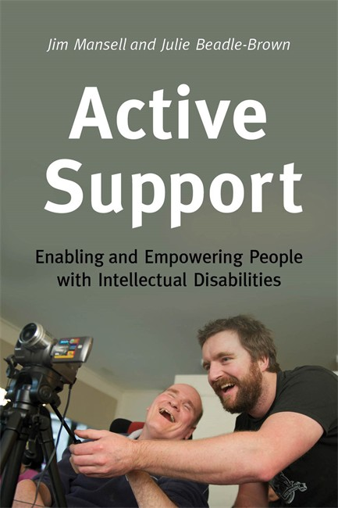
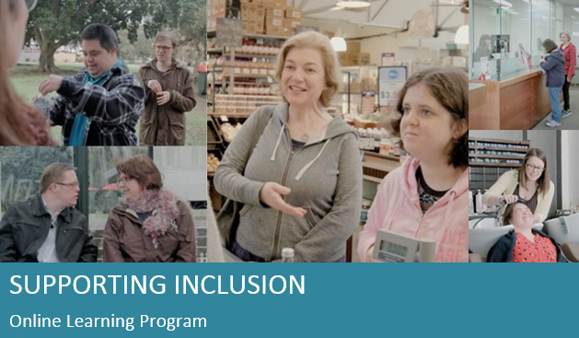
Further Resources
Mansell, J., & Beadle-Brown, J. (2012) Active support: enabling and empowering people with intellectual disabilities, Jessica Kingsley, London.
Skills for Active Support http://www.everymomenthaspotential.com.au
Supporting Inclusion – online training resource. http://supportinginclusion.weebly.com
Frontline Practice Leadership https://www.practiceleadershipresource.com.au
Support for Decision Making - The La Trobe Support for Decision Making
Practice Framework Learning Resource http://www.supportfordecisionmakingresource.com.au/
Enabling Risk: Putting Positives First– On line training program https://www.enablingriskresource.com.au
Notes:
The materials used in this training come from these sources.
Tizard Centre, University of Kent
La Trobe University

Slide 38
Thank
You
Living with Disability Research Centre
http://www.latrobe.edu.au/lids
Email: Lids@latrobe.edu.au

