Slide 1
Active Support: what it is and how to do it
Training developed by the Living with Disability Research Centre

Slide 2
Plan for Today
You will learn about:
What Active Support is and why it is important
Engagement and disengagement
The 4 Essentials of Active Support
How to apply the 4 Essentials in your everyday work.
Please feel free to ask questions at any time
Notes:
You will need 5.5 hours including breaks.
You may want to add in the timetable for the day

Slide 3
Introductions
Where do you work and what is your role in your organisation?
What do you know about Active Support? Or, what have you heard about Active Support?
What do you want to know about Active Support?
Notes:
Important for people to introduce themselves so they can know each other and the trainer knows who the audience is. This will help to anticipate the types of questions that might arise and tailor answers to participants context.
Also it sets the expectation that people will talk to the group and helps them to become comfortable with this early.
Please allow time for the introductions and that this is done properly at it can help set the tone for the rest of the training.

Slide 4
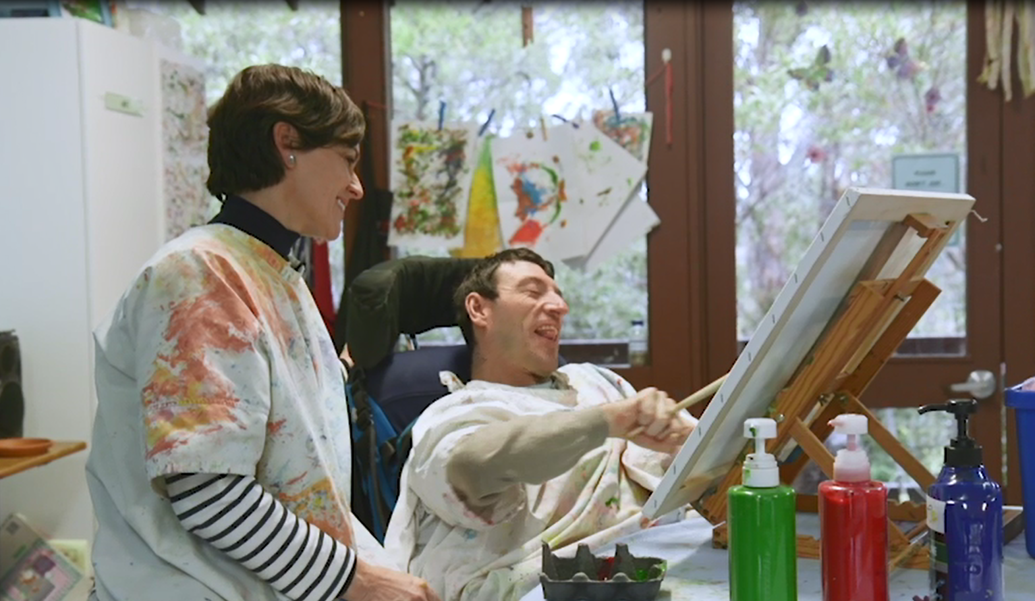
What is Active Support?
“Providing the right support for a person to be engaged
in meaningful activities and social interactions”.
A person centred practice.
Staff can use Active Support all the time – to assist people to be participate in activities and interactions.
It is important because many people with intellectual disabilities need support to:
be engaged
interact with others
communicate
make choices
participate in activities at home or in the community
Notes:
Key messages
– definition of Active Support - be consistent use the word practice – the way staff should provide support all the time
Its important because the people they support need help to do things or interact with others – they often can’t do it on their own
Point out that it is designed for people with intellectual disability – will not keep using that term just refer to the person
Introduce the video which provides lots of examples of active support and explains further why it is important and introduces the 4 essentials
You can use the voice over video or select one without the commentary so you can talk about it in your own words

Slide 6
Engagement
The purpose of Active Support is to support a person to engage in meaningful activities and social interactions.
Engagement means doing things
participating in activities on your own, with another person, in a group
or interacting socially with others.
As you watch the next video think about:
The types of activities people were engaged in
What the staff were doing when people were engaged
Why being engaged in these activities is important to the people in the video
Notes:
Main message - define engagement meaningful activities or social interaction - give a couple of examples of what this might look like ahead of the video eg cooking tea, doing the garden, playing a game – talking to a neighbour, talking to the person serving in a shop
Intro the video

Slide 8
Reflections - Engagement
What types of activities were they engaged in?
What were the staff doing when people were engaged?
Why would being engaged in these types of activities be important for the people in the video?
Notes:
This is just a repeat of what you asked people to do – use it as the prompt for discussion about each of these questions – try to get an equal balance for discussion about each question

Slide 9
Engagement and Quality of Life
Being engaged in meaningful activities and interactions is important to quality of life.
For example,
physical health requires exercise or team games
self-determination relies on having options about how to spend time
personal development is only possible by participating in new experiences or practicing skills
friendships and inclusion depend on interacting with other people
emotional well-being stems from participation and relationships
Think about how much of your day are you engaged?
Notes:
Key message – why engagement is important to quality of life
describe different types of activity or interactions related to different domains of quality of life.
Discussion Prepare for next slide about disengagement by drawing attention to how much of the time people in the room are engaged.
As you do this you can give more examples of engagement in different activities
egs getting dressed and ready for the day, preparing food, eating and drinking, working, talking to people, using a phone or computer, attending to housework, exercising and doing leisure activities.

Slide 10
Level of engagement of the people you support
People living in group homes are engaged on average for 50% of the time
They are disengaged for the other 50% of time
Disengagement means doing nothing – just sitting or standing, waiting, watching what others
Being disengaged
impacts on emotional well-being
contributes to repetitive or self-stimulatory behaviour, and self-injury
means staff don’t see the person as an individual who has interests and preferences
People with severe and profound intellectual disabilities are the most disengaged.
Why do you think this is the case?
Notes:
Main message – people with intellectual disabilities spend a lot of time disengaged - this is very different from staff and others without disability
People with more severe intellectual disabilities are even more likely to be engaged
Prompt discussion about why - Explain they may not initiate engagement in activities or interactions, they may be overlooked by staff or left alone. Staff may not know how to provide them with assistance that enables their participation, or how to interact with them socially.

Slide 11
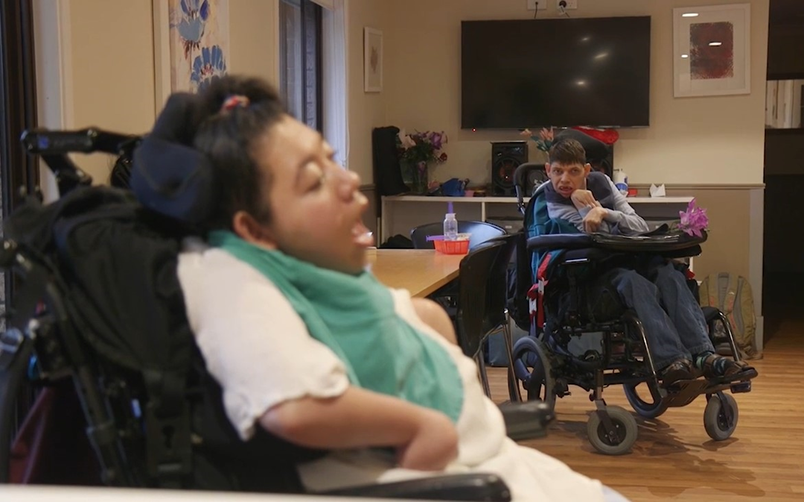
Why are people disengaged?
They may not be able to initiate engagement without support
They may be overlooked by staff or left alone
Staff may not know how to provide the right type of assistance or how to interact with them socially
To reduce disengagement, people need staff skilled in Active Support who :
are responsive to them
encourage them to be engaged
support them to try new or more complex activities and extend their skills
how how to provide the right type and amount of assistance
know when to provide assistance, or stand back and not take over
Notes:
Main message –why people are disengaged – it’s not a choice they need support to be engaged, staff need to pay attention
You may want to expand depending on the audience differences between people with mild and more severe intellectual disability.
- that people with mild intellectual disability may be engaged in passive leisure or simple activities with the right support they could be engaged in more challenging activities if supported to do so

Slide 12
Activity: Engaged / Disengaged
In groups answer the 20 Questions on the
Handout
Notes:
Handout should be printed out for this actvit
Examples of engagement in meaningful activity – participants use the checklist and decide yes or no based on the brief scenario.
Can be done individually, or as pairs. Then feedback to group – ask each pair to talk about the answers to 2 of the scenarios.
Good discussion to draw out things that are meaningful activities and difference between this and passive watching etc.
Use next slide to recap if necessary

Slide 13
Meaningful Activities
Meaningful: constructive, purposeful, contributing to quality of life
Household activities: cooking, making coffee, gardening, putting clothes in a washing machine
Personal care: putting on clothes, eating and drinking, brushing teeth
Leisure activities: watching TV, playing a game, listening to music, exercising, reading
Community-based activities: shopping, eating at a café, visiting an art gallery, borrowing books from a library
Social interactions: talking, listening, signing, gesturing to a friend, house mate, family, neighbour, shop assistant, doctor
Notes:
May not need this slide – just has more examples of meaningful activities

Slide 14
History of Active Support: 1970s to 2000s
Active Support developed to address disengagement of people with intellectual disability
In 1970s in UK institutions and then in the first group homes in 1980s
Two similar models
Tizard Centre University of Kent – Mansell & Beadle Brown
Welsh Centre for Learning Disabilities – Felce, Jones, Perry
Key differences - Tizard model removed paperwork - emphasis on doing Active Support
By mid 2000s introduced in Australia, New Zealand, USA, Taiwan and Sweden
Often mix of Welsh and Tizard models reduced clarity
Initial training often not followed up with practice leadership
Too much paperwork required
Evolving in Australia – no paperwork – clearer training materials – support for good practice
Notes:
Message - developed over a long period – take advantage of opportunities to be engaged in everyday things rather than waiting for special things to happen – eg waiting all day for a 30 min activity session run by a specialist
For audience who have experience of Active Support reassure no longer using paperwork and there is more focus on doing Active Support and support for staff to do it.
Two models – caused confusion – too much paperwork in the Welsh model
Not well implemented in Australia no follow up to training or support to staff

Slide 15
Research Evidence about Active Support
Active Support has a strong evidence base.
More than 20 years of research, mostly in group homes
When staff do Active Support well people with intellectual disabilities:
have higher levels of engagement in meaningful activities and social interactions
exercise more choice
have fewer behaviours of concern
have a better quality of life
It is the one thing that makes most difference to quality of life for people in group homes
It is particularly beneficial for people with severe and profound intellectual disabilities
Active Support is also good for staff giving them clearer purpose and greater satisfaction
Notes:
Main message - There is a lot of evidence about Active Support, if done well by staff it has good outcomes
Best outcomes for people with severe and profound intellectual disability
Good outcomes for staff also
Only staff practice with evidence – out of all the factors Active Support makes the most difference to Q o L
Has stronger evidence than PBS and PCP.

Slide 16
Active Support v a Hotel Model
If staff don’t use Active Support group homes are like hotels where staff do everything for people
Notes:
Main message if you don’t do Active Support you end up doing everything for people and treating them like furniture.

Slide 17
Active Support v Hotel Model
Staff
encourage participation and do things with each person
frequently provide opportunities for people to be engaged in a range of activities
provide the right support for each person to be engaged
offer choices to each person
are attentive, listen and respond to each person’s communication
People in group homes
frequently engage in different activities through the day
are involved in household tasks
frequently interact with staff and are supported
A good service is where
people have good quality of life
each person experiences, choice, participation, inclusion and well-being
relationships are valued
personal care is responsive
Staff
do things for or to a person
do the household tasks
interact and engage with people when tasks are done
focus on leisure activities or going out of the house
People in group homes
have lots of free time
are often disengaged as they are left to entertain themselves
wait for support until staff have finished chores
A good service is where
the house is neat and tidy
domestic tasks are done
personal care needs are paramount
people get out of the house
Notes:
There is a lot in this table, it draws out what is important about Doing and not doing Active Support so worth talking through comparing one with the other on the three domains

Slide 18
Activity
Is the service where you work like the Active Support or Hotel Model?
Can you describe why?
What needs to change so it is more like the Active Support model and less like the Hotel Model?
Notes:
Small group discussion to draw out the distinctions and process understanding of AS

Slide 19
How to do Active Support: the 4 Essentials
Every moment has potential – every task, activity or interaction has opportunities to involve a person
Graded assistance to ensure success – provide the right type of support to assist a person to succeed in an activity or social interaction
​​
Maximising choice and control – offer choices to increase a person’s control over their life
​​
Little and often – support a person to try new things or participate for a short time to increase their experience
Notes:
Next segment going to introduce four essentials and talk about how can use these to do Active Support
Introduce each as one liner and then focus on Every Moment Has Potential these are written so they indicate what the staff member should do –use this phrasing

Slide 20
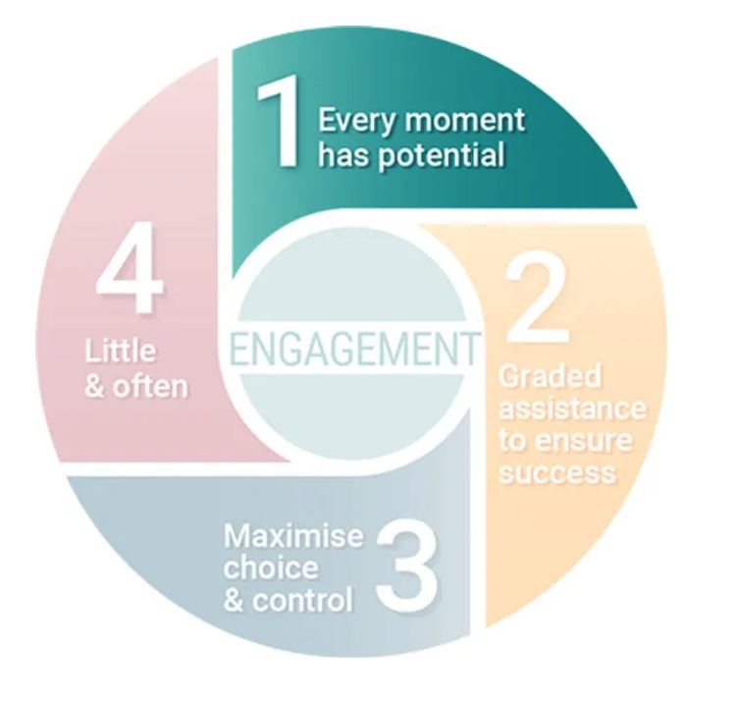
Every Moment Has Potential
Using Every Moment Has Potential means you
recognise the many moments available to engage a person throughout the day
use the opportunities presented everyday tasks to be engaged
break activities down into parts to create more opportunities to engage a person
think in steps
The video explains Every Moment Has Potential
As you watch the video think about the other opportunities that are available in the service where you work
Notes:
Give an example for each of these points and the ask participants to think of other examples
preparing breakfast, choosing clothes to wear, collecting mail, answering the phone, watering plants, emptying bins, writing a shopping list and purchasing items,
Steps involved in cooking, or washing
Introduce next video which explains every moment has potential and ask the questions

Slide 22
Applying Every Moment has Potential – Thinking in Steps
Think: “When I am doing something, how can someone be involved?”
Think in steps and break a complex activity into simpler parts
What are the steps for cooking dinner?
Getting vegetables from the fridge, washing and chopping them, getting utensils, stirring food in a frypan, pouring in sauce and so on
Each of these steps are opportunities for a person to be engaged
They may perform the step independently or with support
What activities and steps are shown in the next video?
What opportunities did staff make for people to be engaged?
Notes:
Message, always be aware of how you can involve a person in task
Example of breaking a task into steps – people don’t have to be able to do steps independently, but sometimes they will only need support for some steps
Introduce the video and what to look for

Slide 24
Activity: Every Moment has Potential
What were the activities and the steps?
What were the opportunities made available for the people supported to participate?
How did the staff apply Every Moment Has Potential?
How engaged were the people participating in the activities?
Notes:
Discussion of the video - depending on the audience you could also get people to think about someone they work with and how they could create opportunities or which might be missed

Slide 25
Applying Every Moment has Potential
Engagement is not just about household activities.
There are many opportunities for social interactions as well.
Asking a person about their day or sharing a story, initiating a conversation between the people who live together, phoning a family member or writing an email to a friend.
There are opportunities for leisure activities and hobbies.
Knitting, sewing, gardening, reading, listening to music, playing a game, exercising, baking, model building, boccia.
There are many opportunities for engagement when a person is in the community.
Selecting and paying for items at a store, choosing a book from a library and checking it out, greeting a waiter, and chatting to a cashier while making a purchase.
Notes:
Message. – engagement is not only about tasks and chores its also being social interaction
Opportunities for engagement in tasks and interaction are in the community as well as at home,

Slide 26
Activity: Every Moment Has Potential
What everyday activities and interactions do the people you support engage in?
What other opportunities might be available to them?
Notes:
Small groups or pairs. Focus on applying EMHP to the people each participant supports.

Slide 27
Summary: Every Moment has Potential
Recognising there are many opportunities for a person to be engaged.
Noticing when someone is disengaged and thinking: What are the opportunities available to them to be engaged right now in this moment?
Whether it is an activity or a social interaction at home or in the community.
By breaking complex activities into simpler steps, you create opportunities for a person to be involved.
Every Moment Has Potential is the 1st of the 4 Essentials of Active Support. It means looking for opportunities for people to be engaged in activities or social interactions. It also means breaking activities into steps. There are many opportunities at home and in the community – you just need
Notes:
Opportunities are available and you can also create them.

Slide 28
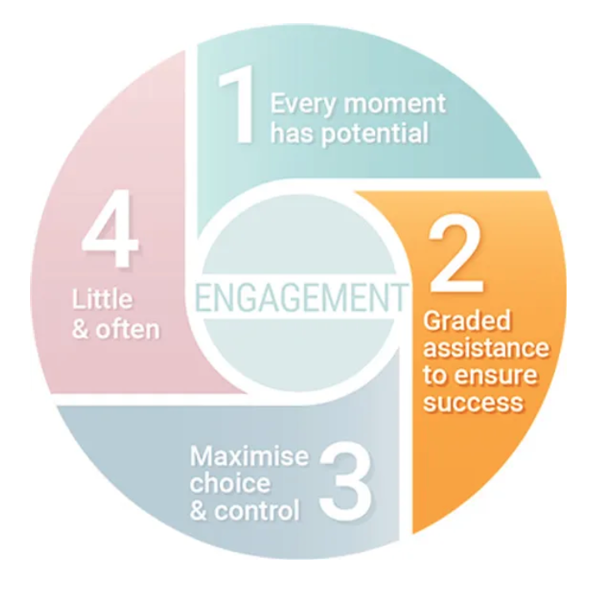
Graded Assistance to Ensure Success
Using graded assistance means providing the right type and amount of assistance a person needs to engage successfully in an activity or interaction
There are different types of assistance.
These are:
Asking: Can you get the milk from the fridge?
Instructing: Press the switch on the kettle.
Prompting or gesturing: Pointing to the cupboard to get a cup.
Demonstrating: Showing the person how to hold a carton to pour milk.
Guiding a person physically: You and the person holding the kettle to pour hot water into a cup.
The type and amount of assistance you provide depends on the person and the activity
Notes:
The second essential is Graded assistance to endure success
Message define Graded assistance – use this consistently,
Explaining there are different types of assistance –
Introduce the video which gives more examples of types of assistance and explain that the type of assistance and how much depends on the person and the task

Slide 30
The Right Type and Amount of Assistance
People need different types and amounts of assistance
Ask yourself - What assistance does a person need to successfully participate in this activity or interaction?
One person may need a prompt, another physical guidance, such as hand-over-hand assistance
One person may need to be shown how to do something, but another just a verbal instruction
Providing the right assistance can mean standing back and letting the person do it themselves
Sometimes you may need to perform a step to keep the activity moving along smoothly.
Making judgements about type or amount of assistance is not always easy:
Too much support takes opportunities away from the person
Too little support can mean they don’t experience success
To use graded assistance well you have to focus on the person.
Notes:
Message everyone will need a different type of assistance and different amounts
It is hard to judge the right amount - if you misjudge it has an impact on the person either they don’t participate as much as they could or they fail in doing the task
Introduce the next video which has more examples of graded assistance
Ask participants to watch for the different types of assistance that was provided by staff

Slide 32
Activity: Graded Assistance
What types of assistance were provided in the video?
When did the staff adjust the types and amounts of assistance they provided and why?
Was the right type and amount of assistance provided to people supported?
Was their participation successful?
Notes:
You might introduce into this discussion – if you don’t know a person well how might you find out more about them

Slide 33
Summary: Graded Assistance to Ensure Success
It takes practice to be skilled in graded assistance.
You have to know each person and learn to judge the right type and amount of assistance they need in each situation, and then how to effectively provide it.
If you use graded assistance well, then the person you support can participate in meaningful activities and social interactions.
Successful participation can be rewarding because there is a feeling of achievement. By experiencing success, the person is more likely to participate again in the future.

Slide 34
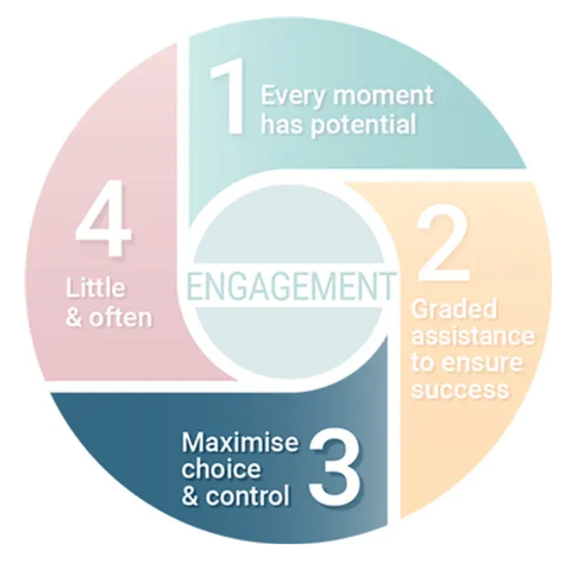
Maximising Choice and Control
Everyday all of us make many choices: when to do things, how to do them, who with and for how long.
Choices reflect preferences – everyone has preferences
When people choose they have more control over their lives
How would you feel if most of the things that happened in your life were decided by someone else?
This is what happens for many of the people you support
Staff maximising choice and control means
Offering more than one option
Ensure options are understood
Respecting and acting on choices
Supporting people to make everyday choices is part of supported decision making
Notes:
3rd Essential message, people make lots of choices often don’t realize they are doing this. Introduce the term preferences, what it feels like when you can’t have your preferences –frustrating - main ideas how to support choice – options, understanding what’s on offer and respecting choice.
More than one option example. Not do you want a shower but do you want a shower now or later
Also a passing link to supported decision making
Introduce the video

Slide 35
Notes:
May not need this but may be useful

Slide 36
Presenting Opportunities to Make Choices
Communication is important when presenting options.
You must present options in ways the person understands.
You can present options :
Verbally: asking - Do you want dinner now or later?
Using signs or gestures - gesturing big and small to decide the size of a drink
Using objects or pictures - showing several books for the person to choose
Using videos to show what something looks like - watching Youtube videos of different places to decide where to visit
Or you can use a combination of these. Such as talking while using objects
You must also decide how many options to offer a person
Should you provide 2 options? Or can you offer more without overwhelming them?
Notes:
Message basic ideas about communicating in different ways to make sure a person understand – Not everyone understands words!
Some people can only make choices between two options for others more options isn’t a problem

Slide 37
Understanding preferences
People communicate their preferences in difference ways
You need know how the person communicates to understand their preferences.
This might be
verbally using words
using signs
by pointing
using gestures
through facial expression
using communication aides.
You may need to give the person time to think about the options.
And once they make a choice, you may need to check you have understood correctly.
Notes:
Message – make sure you have understood preferences, people express them in different ways
Intro the video examples of staff supporting choice and control Ask participants to think about
How did the support workers provide opportunities to make choice?
How did each person communicate their choice?
Did each person have choice and exercise control?

Slide 39
Activity: Choice and Control
How did the staff provide opportunities to make choice?
How did each person communicate their choice?
Did each person have choice and exercise control?
Notes:
Lead discussion on the video

Slide 40
Summary: Maximising Choice and Control
Recognising that each person you support has preferences.
Providing them with opportunities to choose what happens in their life.
To support a person to make choices, you must pay attention to communication:
How you present information about options
How a person receives information and understands it
How a person makes their preferences known

Slide 41
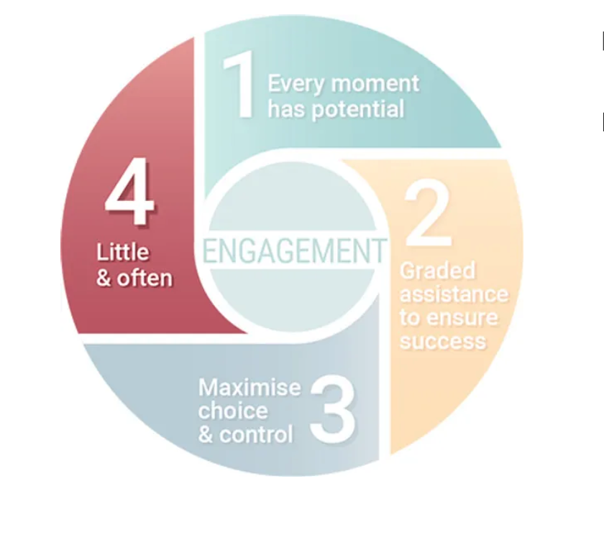
Little and Often
Little and often helps you recognise
People participate in different ways
Some people like to dip and and out of an activity
Using little and often means you:
support a person to take a break if they need one
support a person to return to an activity when they are ready
Little and often also helps you recognise
Doing new activities can be hard and may mean a person participates for only a short time
As a person gets more familiar with an activity they may participate for longer
When a person stops participating they may return to it again later
Notes:
Introduce idea of little and often – note it can be confusing as it has several different elements these are set out in the slide
Introduce the video which illustrates little and often –

Slide 43
Applying Little and Often
You must pay attention to the person you are supporting:
How much are they engaged in the activity?
Do they want to continue or have a break?
If they have a break, make sure they have an opportunity to return
Watch out for when they are ready to return
When a person is engaged in a new experience
Give them time to see what it is like, how to do it and what’s involved.
Make sure they have another opportunity to try it for longer.
This can help to build up experience and competence.
Notes:
Key message pay attention to how the person is responding – if they stop – its ok- leave the opportunity for them to return. -
People often participate in new experiences for a short time. - don’t assume they don’t like something if they stop – next time they may try for longer
Introduce the video, that has examples of applying little and often - watch for how little and often is used. Why was it important for the people in the video

Slide 45
Activity: Little and Often
What does participation look like for each of the people in the video?
How was Little and Often used?
Why do you think it is important that they were supported using Little and Often?

Slide 46
Summary: Little and Often
Little and Often recognises people participate in different ways
You need to go at the pace of the person
A person may need a break from the activity and encouragement when they return
Little and often is useful when introducing a person to a new activity - over time they may participate for longer

Slide 47
Recap Day 1
What is engagement? What are some examples of engagement?
What is disengagement? What are some examples of disengagement?
What is the purpose of Active Support?
What are the names of the 4 Essentials of Active Support?
How do you apply each of them in practice?

